Slide 1
The Quest to Automate Fact-Checking
Naeemul Hassan ¹, Bill Adair ², James T. Hamilton ³,
Chengkai Li ¹, Mark Tremayne¹, Jun Yang ², Cong Yu ⁴
University of Texas at Arlington ¹, Duke University ², Stanford University ³, Google Research ⁴
2015 C+J, October 2-3, New York, NY

Slide 2
Fact-checking is growing, but human challenges remain
64 active fact-checking sites in the world, up from 44 in 2014
New sites in Russia, Canada, Nepal, Northern Ireland
Falsehoods growing faster than fact-checkers
Labor-intensive journalism
1 fact-check = 1 day of work

Slide 3
Computation + Fact-checking = Opportunities
Create tools, apps to assist journalists doing fact-checking
Finding factual claims (ClaimBuster)
Analyzing claims (iCheck)
Create tools, apps to assist consumers
Browser extensions to match claims & fact-checks (TruthGoggles - achieveable)
Instant matching of claims and fact-checks (The Holy Grail)

Slide 4
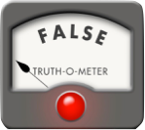
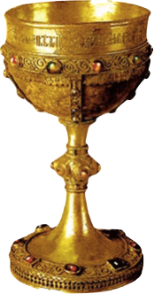
The Holy Grail
Instant
automated matching of political claims and fact-checks

Slide 5
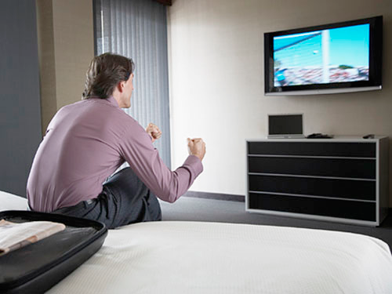
The Holy Grail

Slide 6

The Holy Grail

Slide 7
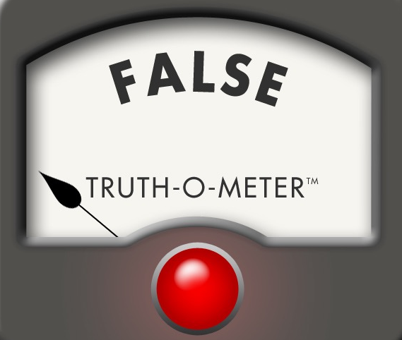
The Holy Grail

Slide 8
Technical hurdles for pop-up
fact-checking
Most fact-checks published in old blog formats such as WordPress
Most are not in structured journalism format that would allow more flexibility, easier matching
Current publishers have inconsistent coding (if any) for video, campaign ads
Vagueness, natural language variation
“Preventive health care saves money”
“Does preventive care save money? No.”

Slide 9
Next Steps
Build ClaimBuster, which detects factual claims
Develop apps to detect political messages in video/audio
YouTube / Browser extension (achievable)
Cable / Broadcast TV app (difficult)
Apple TV app (difficult)

Slide 10

ClaimBuster
Detects Check-worthy Factual Claims in Political Discourses

Slide 11




Overview
Human Annotation
Ground Truth
Feature Extraction
Feature Vectors
Learning Algorithm
ClaimBuster
Presidential Debate Transcripts

Slide 12
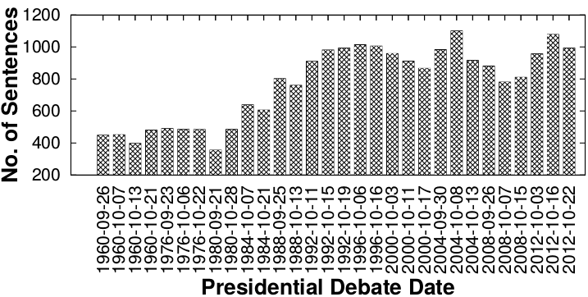
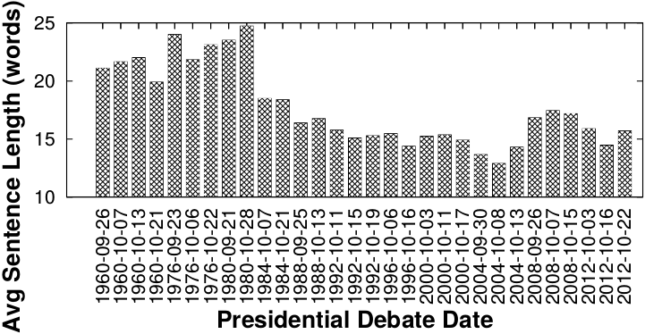
Presidential Debate Transcript
Source: http://www.debates.org/index.php?page=debate-transcripts
All 30 debates (11 elections) in history: 1960, 1976—2012
20k sentences by presidential candidates: removed very short (< 5 words) sentences

Slide 13
Example of Sentences & Problem Modeling
Important factual claims (CFS)
“We spend less on the military today than at any time in our history.” “The President’s position on gay marriage has changed.” “More people are unemployed today than four years ago.”
Unimportant factual claims (UFS)
“I was in Iowa yesterday.” “My mother enjoys cooking.” “I ran for President once before.”
Sentences with no factual claims [opinions, questions] (NFS)
“Iran must not get nuclear weapons.” “7% unemployment is too high.” “My opponent is wishy-washy.” “I will be tough on crime.” "Why should we do that?“ “Hello, New Hampshire!” “Our plan is to reduce tax rate by 10%.”
Goal
Given a sentence, find the class it belongs to.
A supervised learning problem

Slide 14
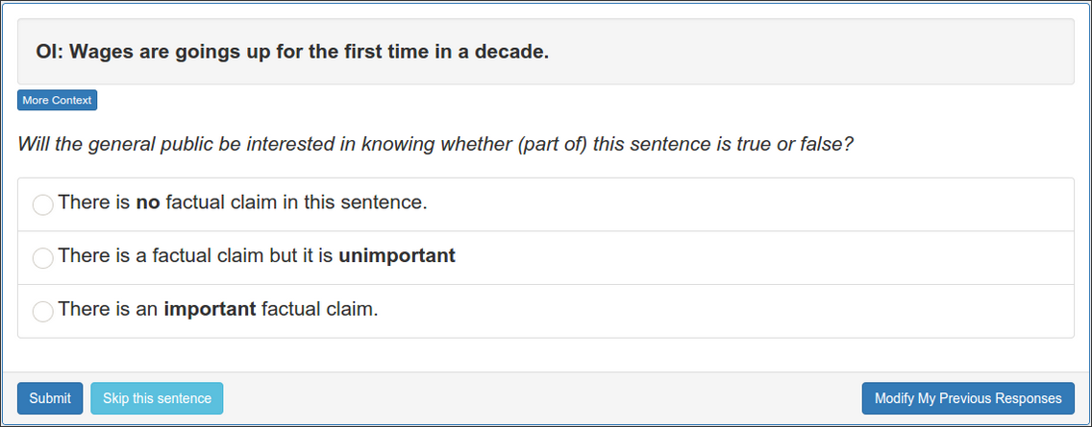
Ground Truth Collection
Developed a data collection platform bit.ly/claimbusters
In 3 months, we accumulated 226 participants.
Used 600 screening sentences to detect spammers & low-quality participants.
Used the sentences which are agreed by at least 2 top-quality participants.
8015 such sentences.
Class | Count
CFS | 1673
UFS | 482
NFS | 5860

Slide 15
Feature Extraction
Keywords:
state, legislature, 87, percent, democrat
Sentiment: 0.032
I was in a state where my legislature was 87 percent Democrat.
Part-of-Speech:
Noun
Entity Type:
Quantity
Concept:
United States
Sentiment: [-1.0 to 1.0]
Words: tf-idf scores of 6130 words (excluding rare words)
POS Tag: 43 tags
Entity Type: 26 types

Slide 16
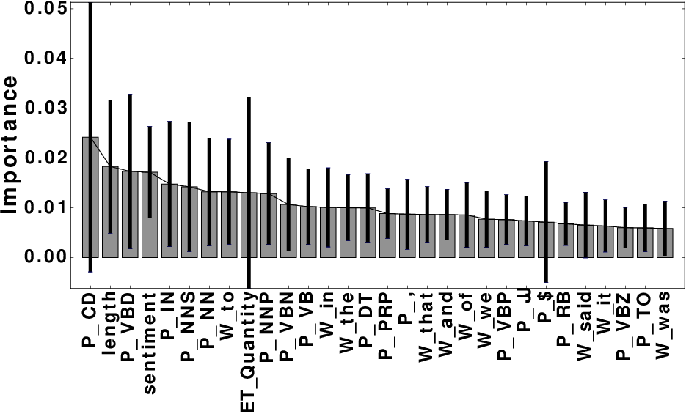
Feature Selection
Total 6201 features
Used a Random Forest Classifier to calculate importance of each feature.
Most Important Feature: POS tag ‘Cardinal Number’
Word | percent; people; jobs
POS tag | noun; cardinal number; past tense; preposition
Entity Type | Quantity; Country; FieldTerminology; Person
Concept | United States Senate; Barack Obama

Slide 17
Evaluation [classification]
4-fold cross validation.
Algorithms: Naive Bayes, Random Forest & Support Vector Machine.
Support Vector Machine performed better than others in general.
 | Precision | Recall | F-measure
NFS | 0.90 | 0.96 | 0.93
UFS | 0.65 | 0.26 | 0.37
CFS | 0.79 | 0.74 | 0.77

Slide 18
Case Study: #GOPDebate2015
Near real-time experiment with 2015 first Republican primary debate transcript.
Transcript grabbed from Closed Captions using TextGrabber device.
1393 sentences.
71% of the facts checked by CNN, factcheck.org & PolitiFact were present in ClaimBuster ranked top (18%) sentences.

Slide 19
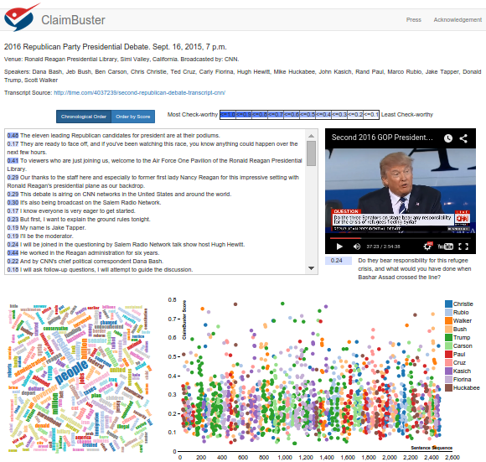
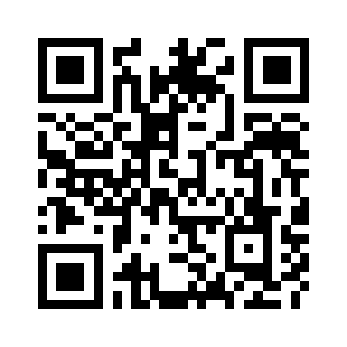
Demo
http://idir.uta.edu/claimbuster

Slide 20
Next Step: Many Things to Look at
Automatically detect check-worthy claims from social media data, websites, live streams, etc.
Check claims by matching with a curated repository of fact-checks.
Better engagement with professional fact-checkers and voters by providing them instant fact-checks.

Slide 21

Acknowledgment
Disclaimer: This material is based upon work partially supported by the National Science Foundation Grants 1018865, 1117369, 1408928, 1408846 and 1408915. Any opinions, findings, and conclusions or recommendations expressed in this material are those of the author(s) and do not necessarily reflect the views of the funding agencies.

Slide 22
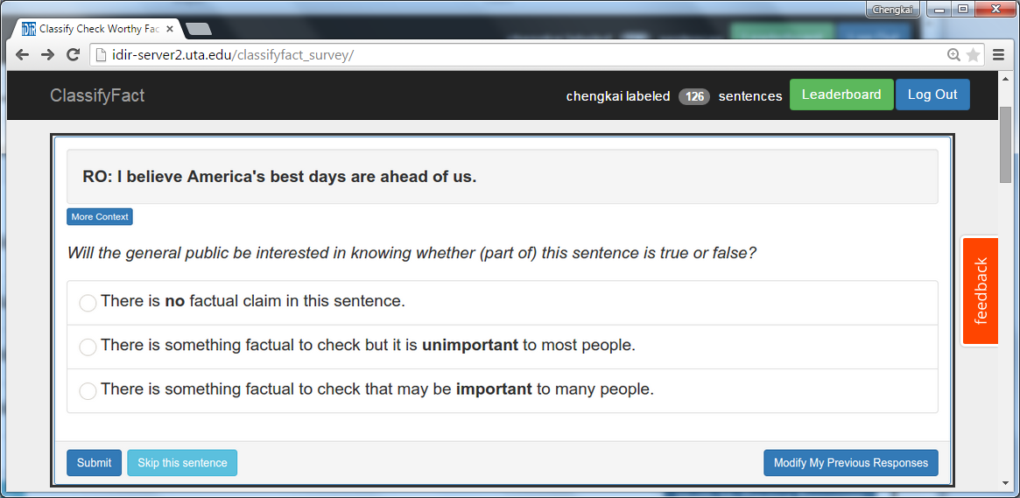
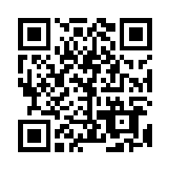
Thank You! Please help us label the data
http://bit.ly/claimbusters

Slide 23
Case Study: #GOPDebate2015
CNN Claim | Associated sentence(s)[From TextGrabber] | Score
1 | Part of this iranian deal was lifting the international sanctions on general sulemani. | 0.415
2 | I would go on to add – >> you don’t favor – >> i have never said that. | 0.511
3 | A majority of the candidates on this stage supported amnesty. | 0.295
4 | Timely the medicaid is growing at one of the lowest rates in the country. | 0.534
4 | We went from $8 billion in the hole to $5 million in the black. | 0.773
5 | And the mexican government is much smarter, much sharper, much more cunning and they send the bad ones over because they don’t want to pay for them. | 0.215
6 | [Not found in the transcript] | N/A

Slide 24
Evaluation [ranking]
Measured accuracy of top-K sentences.
ClaimBuster has a strong agreement with high-quality human coders on the check-worthiness of sentences
K | P@K | NDCG@K
25 | 1 | 1
50 | 1 | 1
100 | 0.960 | 0.970
200 | 0.940 | 0.951
300 | 0.853 | 0.881
500 | 0.690 | 0.840

